Slide 1
Lead Scoring Case Study
Sivagiri

Slide 2
agenda
Problem statement 3
Problem approach 7
EDA Correlations 9
Model Evaluation 17
Conclusion 19

Slide 3

Problem statement
An education company named X Education sells online courses to industry professionals.
On any given day, many professionals who are interested in the courses land on their website and
browse for courses. They have process of form filling on their website after which the company
that individual as a lead.
Once these leads are acquired, employees from the sales team start making calls, writing emails,
etc. Through this process, some of the leads get converted while most do not.
The typical lead conversion rate at X education is around 30%. Now, this means if, say, they
acquire 100 leads in a day, only about 30 of them are converted. To make this process more
efficient, the company wishes to identify the most potential leads, also known as Hot Leads.
If they successfully identify this set of leads, the lead conversion rate should go up as the sales
team will now be focusing more on communicating with the potential leads rather than making
calls to everyone

Slide 4
Business Objective
Lead X wants us to build a model to give every lead a lead score between 0 -100 . So that they can identify the Hot leads and increase their conversion rate as well.
The CEO want to achieve a lead conversion rate of 80%.
They want the model to be able to handle future constraints as well like Peak time actions required, how to utilize full manpower and after achieving target what should be the approaches.

Slide 5
primary goals

Slide 6
There are quite a few goals for this case study:
Build a logistic regression model to assign a lead score between 0 and 100 to each of the leads which can be used by the company to target potential leads. A higher score would mean that the lead is hot, i.e. is most likely to convert whereas a lower score would mean that the lead is cold and will mostly not get converted.
There are some more problems presented by the company which your model should be able to adjust to if the company's requirement changes in the future so you will need to handle these as well. These problems are provided in a separate doc file. Please fill it based on the logistic regression model you got in the first step.

Slide 7
Problem Approach
Importing the data and inspecting the data frame
Data preparation
EDA
Dummy variable creation
Test-Train split
Feature scaling
Correlations
Model Building (RFE R-squared VIF and p-values)
Model Evaluation
Making predictions on test set

Slide 8
Data Manipulation
Total Number of Rows =37, Total Number of Columns =9240.
Single value features like “Magazine”, “Receive More Updates About Our Courses”, “Update me on Supply”
Chain Content”, “Get updates on DM Content”, “I agree to pay the amount through cheque” etc. have been dropped.
Removing the “Prospect ID” and “Lead Number” which is not necessary for the analysis.
After checking for the value counts for some of the object type variables, we find some of the features which has no enough variance, which we have dropped, the features are: “Do Not Call”, “What matters most to you in choosing course”, “Search”, “Newspaper Article”, “X Education Forums”, “Newspaper”, “Digital Advertisement” etc.
Dropping the columns having more than 35% as missing value such as ‘How did you hear about X Education’ and ‘Lead Profile’.

Slide 9
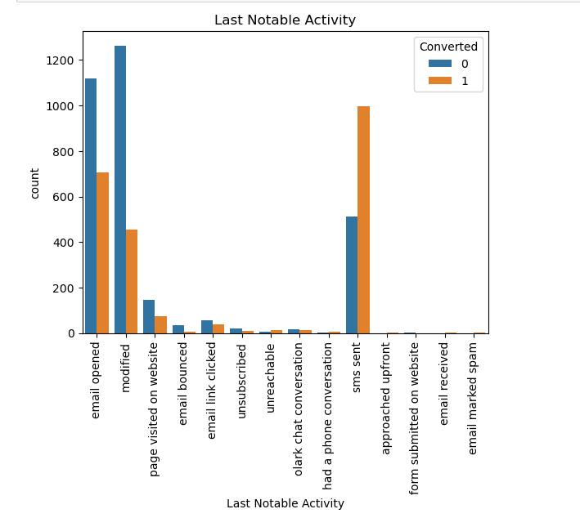
EDA

Slide 10
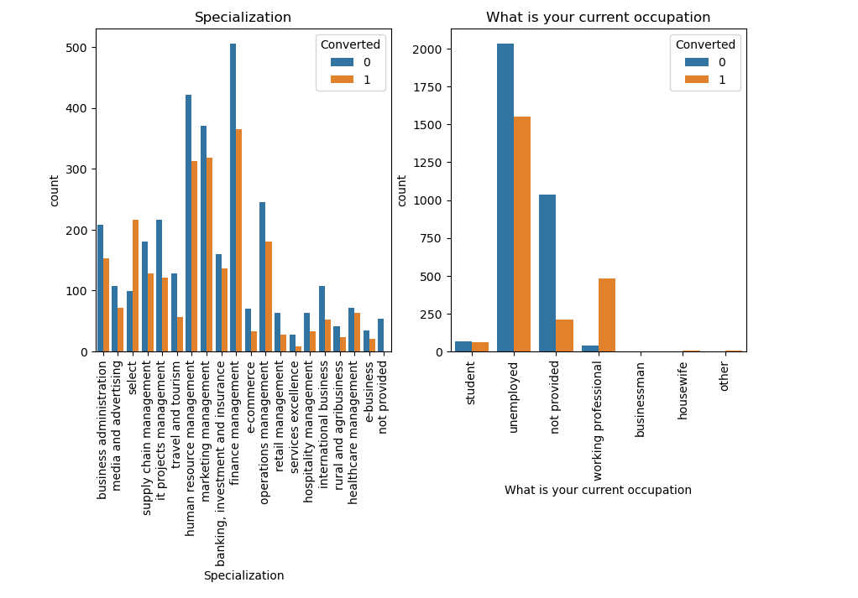
Leads from HR, Finance & Marketing management specializations are high probability to convert. Leads which are Unemployed are more interested to join the course than others.

Slide 11
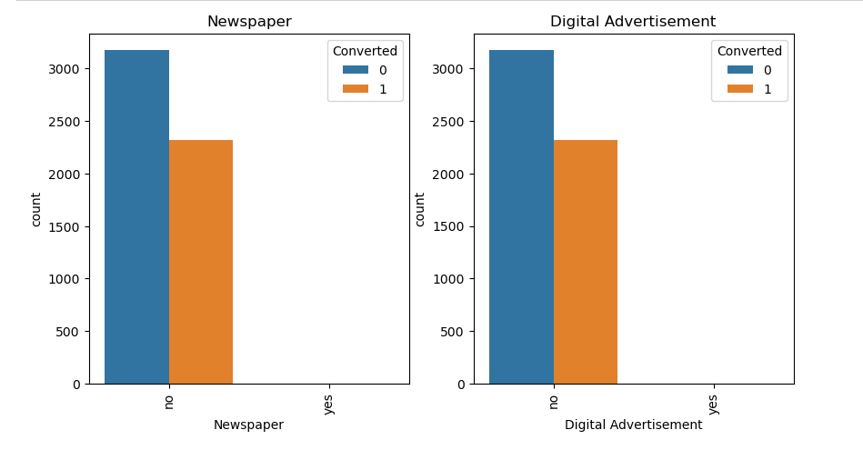

Slide 12
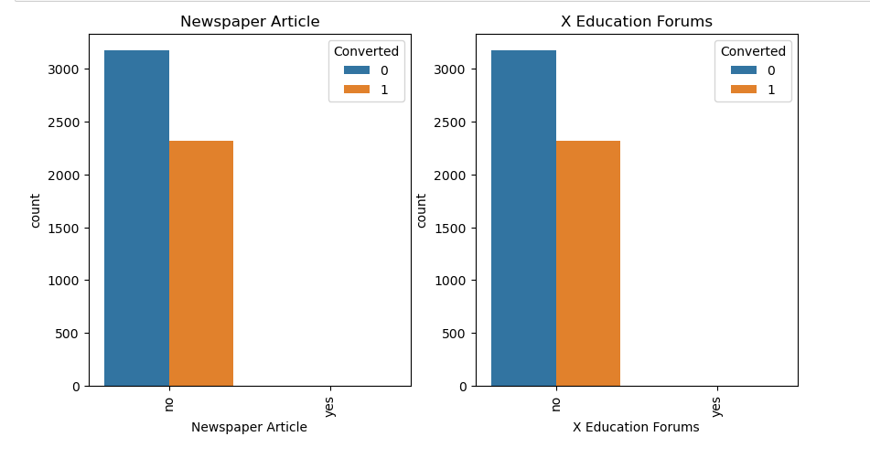

Slide 13
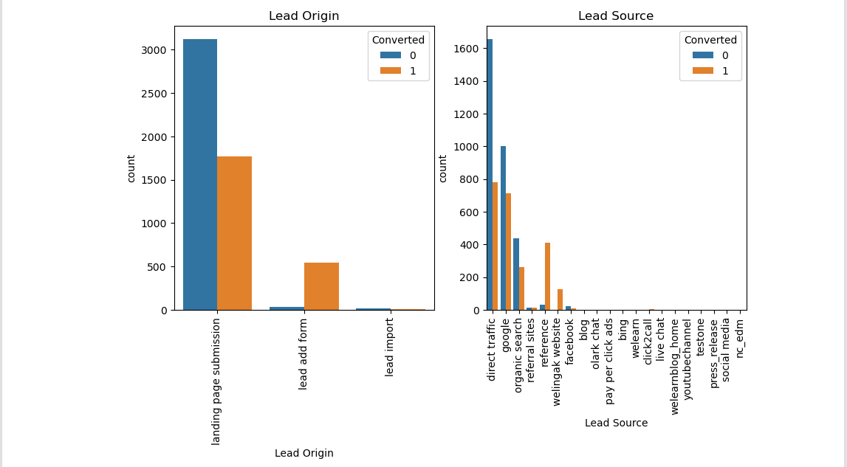
Categorical Variable Relation
In lead source the leads through google & direct traffic high probability to
convert

Slide 14
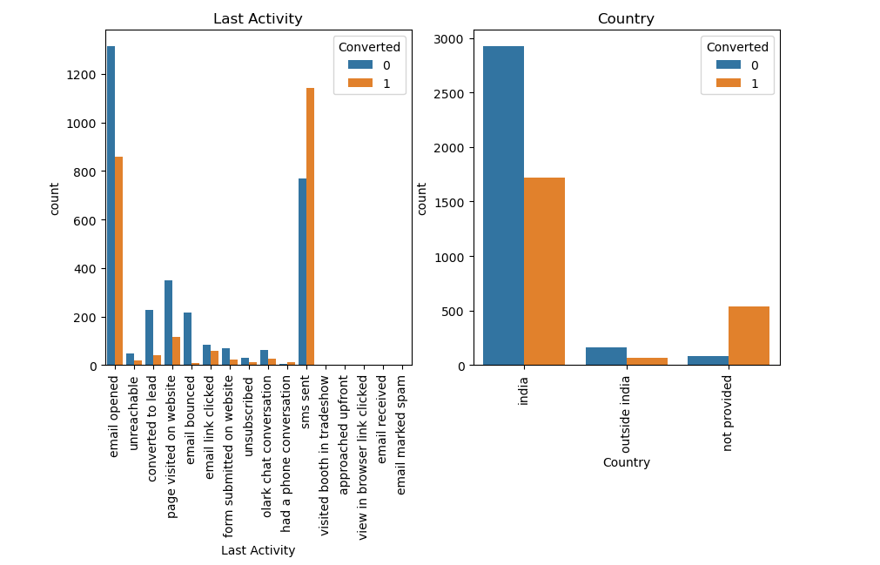
Leads which are opening email have high probability to convert, Same as Sending SMS will also benefit.

Slide 15
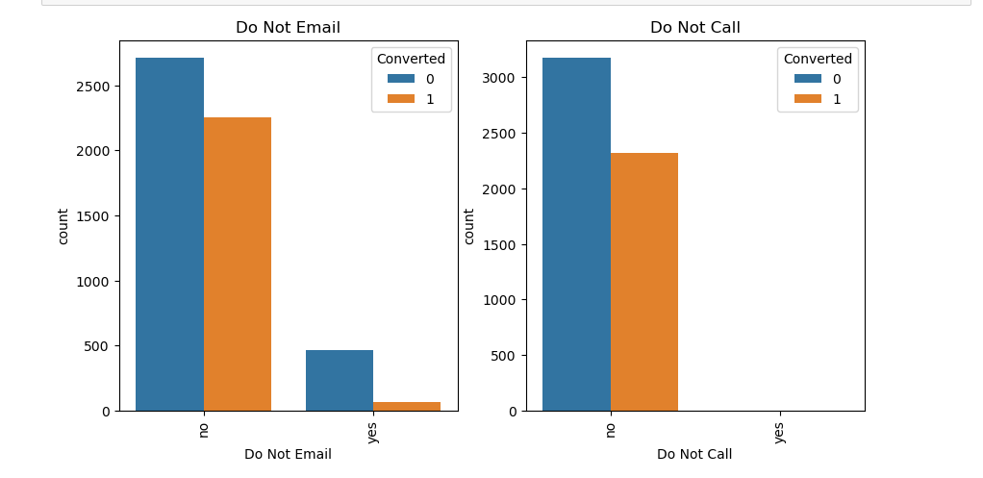

Slide 16
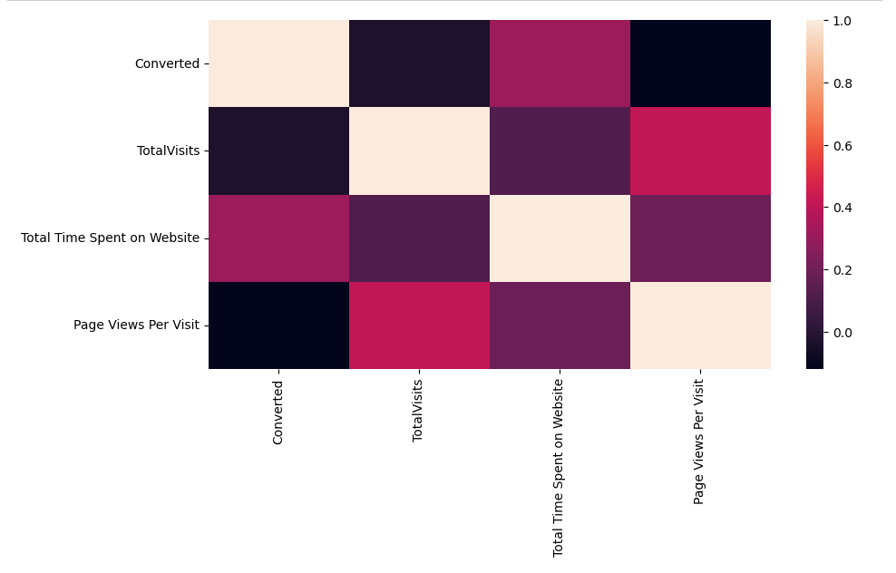
Correlation There is no correlation between the variables

Slide 17
Model Evaluation
Splitting the Data into Training and Testing Sets
The first basic step for regression is performing a train-test split, we have chosen 70:30 ratio.
Use RFE for Feature Selection
Running RFE with 15 variables as output
Building Model by removing the variable whose p-value is greater than 0.05 and vif value is greater than 5
Predictions on test data set
Overall accuracy 81%

Slide 18
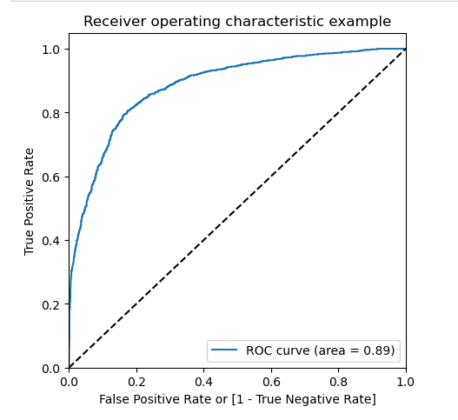
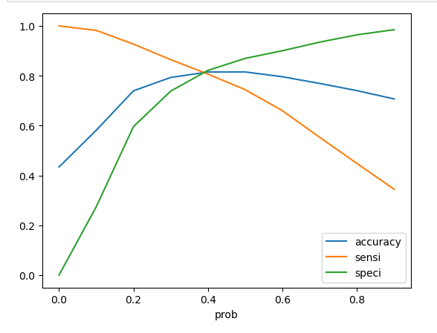
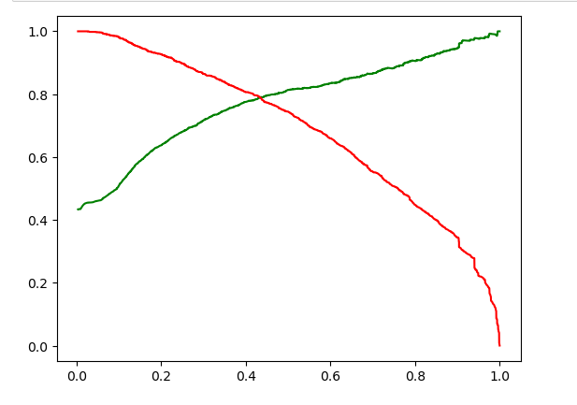
ROC Curve
Finding Optimal Cut off Point
Optimal cut off probability is that
probability where we get balanced sensitivity and specificity.
From the second graph it is visible that the optimal cut off is at 0.35.
0.42 is the tradeoff between Precision and Recall -
Thus, we can safely choose to consider any Prospect Lead with Conversion Probability higher than
42 % to be a hot Lead

Slide 19

Conclusion
It was found that the variables that mattered the most in the potential buyers are (In descending order):
The total time spend on the Website.
Total number of visits.
When the lead source was:
a. Google
b. Direct traffic
c. Organic search
d. Welingak website
When the last activity was:
a. SMS
b. Olark chat conversation
When the lead origin is Lead add format.
When their current occupation is as a working professional.
Most of leads current occupation is Unemployed, which means gave more focus on unemployed leads. the lead origin is Lead add format.
Keeping these in mind the X Education can flourish as they have an extremely high chance to get almost all the potential buyers to change their mind and buy their courses.

Slide 20
Thank you
Sivagiri
Github

